Slide 1
Training content : 18-Apr-2024
Keywords
Operators
Conditional statements
Module, Class
User defined & Built-in functions
Lambda functions
File handling

Slide 2
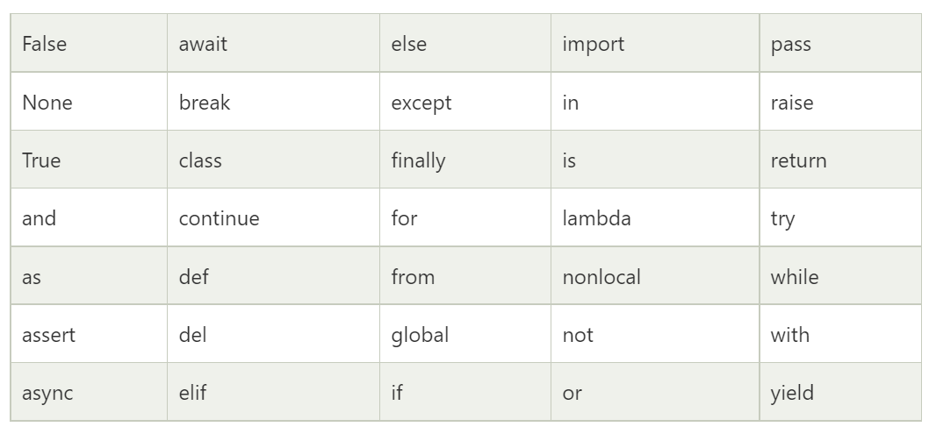
Keywords :

Slide 3
True : equivalent value is 1
bool() – used to check values in - Strings and lists which has items, non-zero numbers.
False : equivalent value is 0
bool() – used to check values in – empty Strings and lists which has no items, zero number.
None : It is same as Null, in other languages - If a function does not have return statement, None is returned by Python interpreter.
in : used in iteration of Lists, dictionaries, tuples, strings
Is : used to check the memory of two objects.
== : used to check values with in two objects.
print( [] == [] )
print( [] is [] )

Slide 4
Conditional & loop statement :
If , elif , else
For , while

Slide 5
Modules :
Commands : -- import sys -- from sys import

Slide 6
Class :
class Person: def __init__(self, name, age): self.name = name self.age = age p1 = Person("John", 36) print(p1)

Slide 7
nonlocal : used in nested function - to indicate a variable within a inner function – to say that particular variable is located in the outer function.
Example : def the_outer_function():
var = 10
def the_inner_function():
nonlocal var
var = 14
print("The value inside the inner function: ", var)
the_inner_function()
print("The value inside the outer function: ", var)
the_outer_function()

Slide 8
Exception handling : -- try, except, else, finally
Exception Handling Keywords - try, except, raise, finally, and assert
# initializing the numbers
var1 = 4 , var2 = 0
# Exception raised in the try section
try:
d = var1 // var2 # this will raise a "divide by zero" exception.
print( d )
except ZeroDivisionError:
print("We cannot divide by zero")
except :
print(‘’)
finally:
print("This is inside finally block")

Slide 9
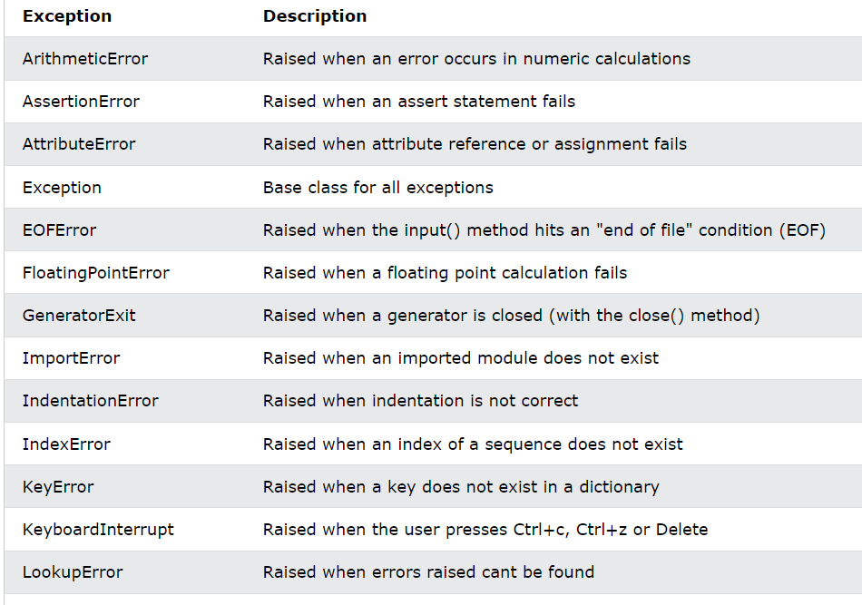

Slide 10
Functions :
Syntax :
- function header should start with keyword 'def'
- function header is terminated by a colon (:).
- function name must follow the same rules as naming variables.
- arguments are optional - as in other languages
- use a documentation string called docstring - to explain the purpose of the function.
- return statement - to return a value from a defined function
- if no return statement, as a default, None is returned by interpreter. - arguments are passed by reference - Variable length parameters : * - for simple parameters
** - for key,value parameters.

Slide 11
assert :
print ("The value of var1 / var2 is : ")
assert var2 != 0, "Divide by 0 error"
print (var1 / var2)
pass : - a null sentence is called a pass
- a create a function that has not been coded : def function_pass( arguments ): pass - to create an empty class : class passed_class: pass

Slide 12
Built-in functions :
List of built-in functions : Built_In_Functions.txt
Class method, static method, instance method
Lambda functions :
Syntax :
- lambda [argument1 [,argument2... .argumentn]] : expression

Slide 13
Modules :
Using ‘import’ keyword
Alias name for a imported module
Import part of a module - Using ‘from’ keyword
Array module :
import array as arr
a = arr.array('i', [2, 4, 5, 6])
-- For string array, list or tuple should be used.

Slide 14
File handling :
Syntax : - to open a file : fileobject = open(<file-name>, <access-mode>, <buffering>) - to read content fileobject.read()
- to close a file : fileobject.close()

Slide 15
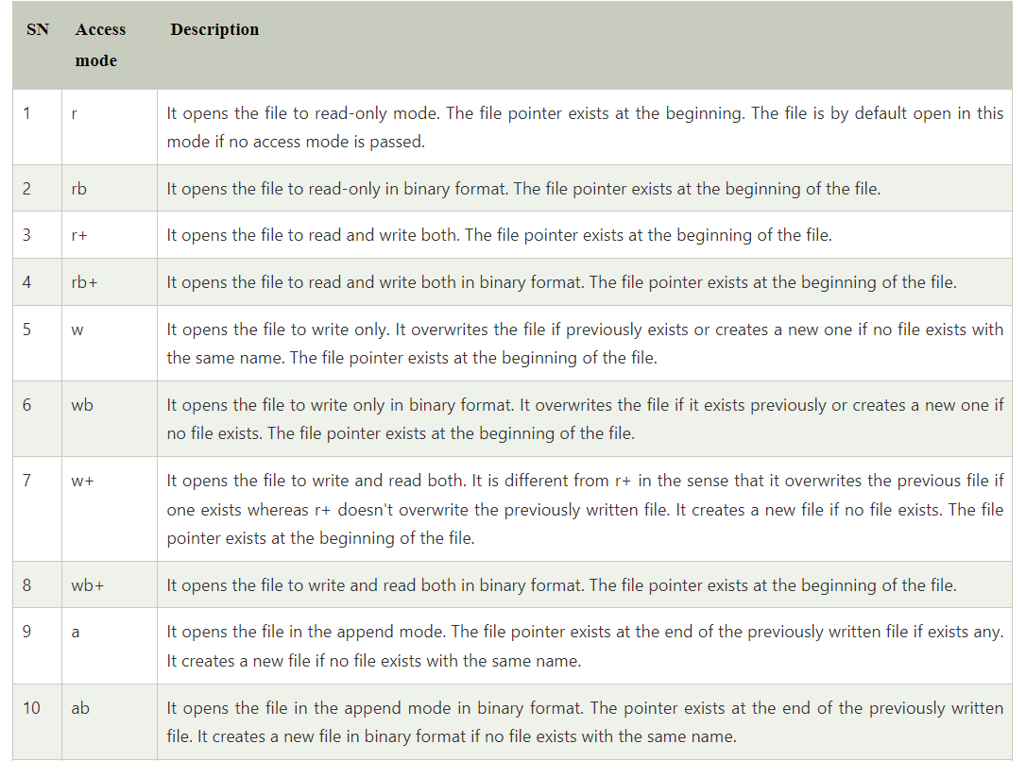
File access modes :

Slide 16
Related websites :
For download – version 3.11.1 : https://www.python.org/downloads/
Developers guide : https://devguide.python.org/
Python repository : https://pypi.org/ (Python Package Index (PyPI) - Similar to GitHub, Maven repository).
Python usage in industries : https://brainstation.io/career-guides/who-uses-python-today
Data science : https://towardsdatascience.com/

Slide 17
Difference between ‘declare’ & ‘definition’ ?? class Orderhandling : def placeOrder() :
pass class OrderHandling {
public void placeOrder(ItemList items) { totalPrice = totapPrice + items[0].price;
}
}

